Slide 1
All about careers.
Explore the future you.
KS5
March 2020

Slide 2
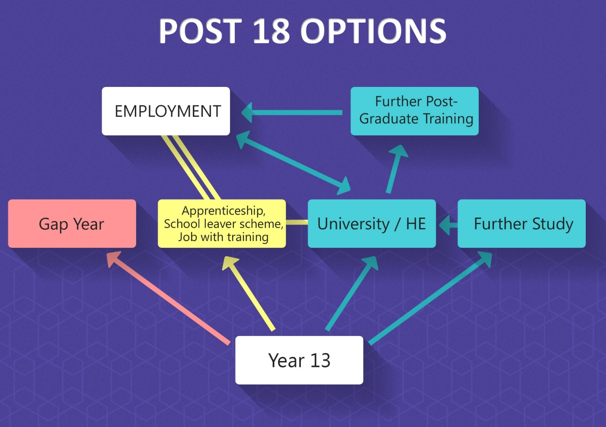
Key Stage 5 – Years 12 & 13

Slide 3
Find out what a job involves and is it right for you.
There are no right or wrong answers here
Which careers match your personality?
Want tips on how to get started?
Do you use Twitter? Look at National Careers Week.
Want to do some worksheets that are real-life puzzles in the world of work?
How about some inspiring stories? Note down your “I never knew that!” moments
Interested in the film industry? Construction? Digital? STEM? NHS?
Are you creative but unsure of options?
Careers menu. Click and explore.
Note down your “I never knew that!” moments

Slide 4
Find out what a job involves and is it right for you
There are no right or wrong answers here
Which careers match your personality?
Want tips on how to get started?
Get it together!
Want to do some worksheets with real-life problems in the world of work?
How about some inspiring stories?
Interested in the film industry? Construction? Digital? STEM? NHS? Are you creative but unsure of options? What else?

Slide 5
Find out what a job involves and is it right for you. Click on the links
Start with an industry sector that interests you. Click here if you’re not sure
Make a lists ‘Top 5 dream jobs for me and routes into them’. Discuss your skills and attributes with your friends/family. Do they agree?
Still unsure? Complete a skills health check
More on skill building from the experts
These jobs actually exist! Don’t limit yourself
Note down your “I never knew that!” moments
CLICK FOR MAIN MENU

Slide 6
Which careers match your personality? Click on the links
Click Explore – Job Types & Employers. Click on 3 sectors that you are already interested in. Now 3 sectors you don’t know much about.
Click Explore – Career Paths. Which can you reject? Remember you can only do this once you’ve done some research. Follow all links
What if your qualifications aren’t enough? There are lots more options
Want study tips?
Still feel there are barriers? Click on Explore – Life events
Note down your “I never knew that!” moments
CLICK FOR MAIN MENU

Slide 7
Want tips on how to get started? Click on the links
5 ways to start thinking about careers
Is following your passion a good option?
How does your learning matter?
What can you do outside college to make you more employable?
Know the difference between the public and private sector?
What else can you find out? Explore, explore, explore
Note down your “I never knew that!” moments
CLICK FOR MAIN MENU

Slide 8
Film industry? Design / Design / Visual Effects / Continuity and more *Why not ask an expert?
What about construction?
A career in STEM. What about this family challenge? Look on Twitter
Here you properly develop your digital skills and gain some industry recognised awards
You won’t believe the job opportunities in the NHS!
Creative but unsure?
What about another sector. What can you find out independently?
Note down your “I never knew that!” moments
CLICK FOR MAIN MENU

Slide 9
What about some inspiring stories?
Do we still have gender issues in careers?
Scroll through these videos. Which caught your eye? Was the job what you expected it to be?
Still not found what you’re looking for? More clips here
Thinking of staying in Lancashire?
Note down your “I never knew that!” moments
CLICK FOR MAIN MENU

Slide 10
Think what you need and get it ready. There’s lots of support out there for:
CVs
Interviews
Applications for apprenticeships, college and university
Do you know how to find an apprenticeship?
Click here
Do you really know about apprenticeships?
Thinking about university?
The world is my oyster. More info please
Note down your “I never knew that!” moments
CLICK FOR MAIN MENU

